Slide 1
CROP DISEASE
USING CNN
MODEL

Slide 2
MACHINE LEARNING
Machine Learning (ML) is concerned with computer programs that automatically improve their performance through experience.

Slide 3
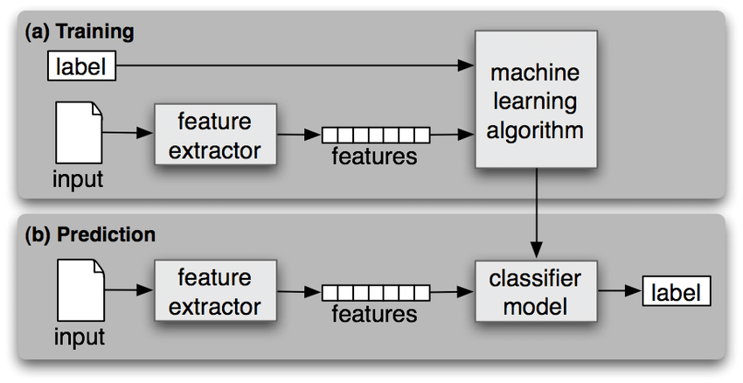
Notes:
The process of training an ML model involves providing an ML algorithm (that is, the learning algorithm) with training data to learn from. The term ML model refers to the model artifact that is created by the training process. ... We can use the ML model to get predictions on new data for which you do not know the target.

Slide 4
WHY ML ?
Increasing demand of data scientist in real world is on peak.
Increasing computational power.
Growing progress in available algorithms and theory developed by researchers.
Flood of available data on internet.

Slide 5
The concept of learning in a ML system
Learning = Improving with experience at some task
- Improve over task.
- With respect to performance
- Based on experience

Slide 6
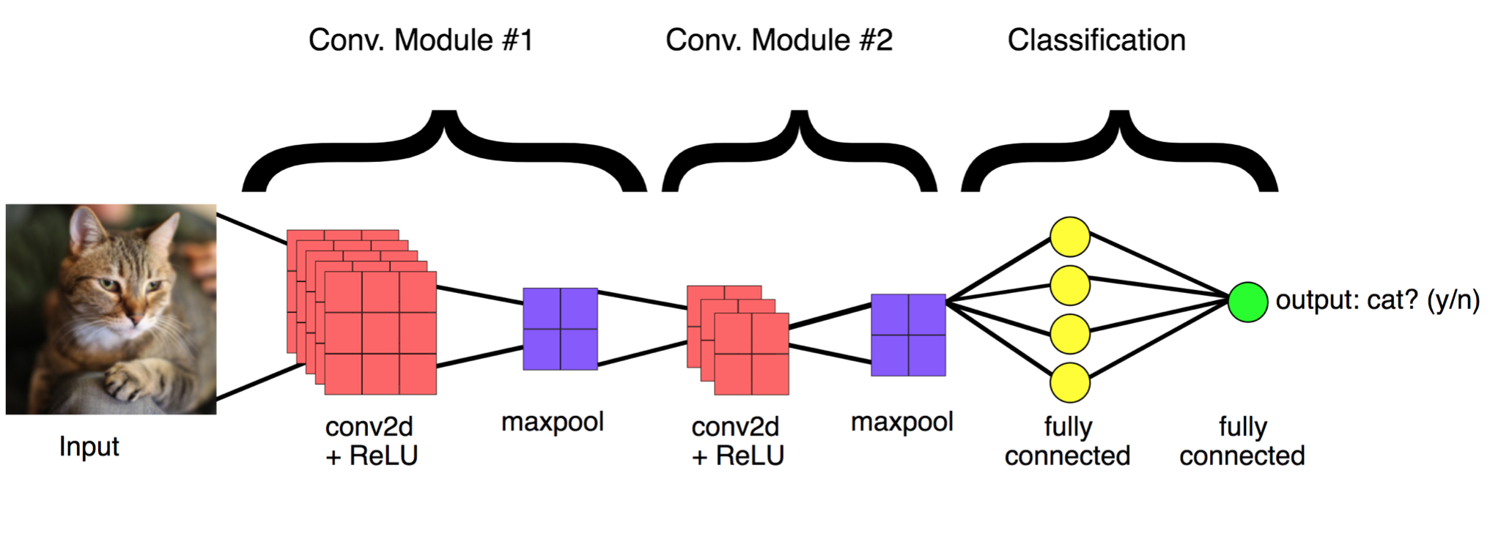

Slide 7
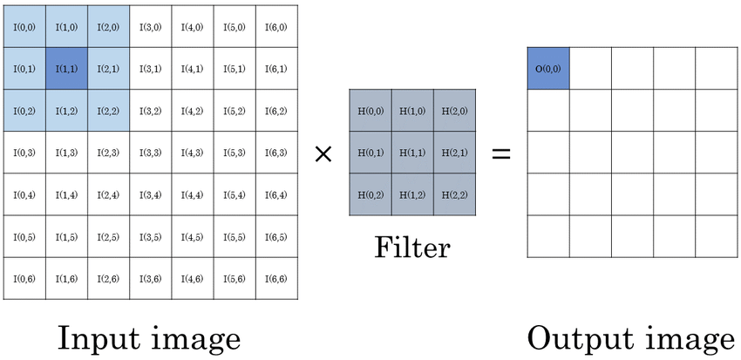
STEPS for model
Step-1 :Input image
Step-2 :Convolution
Apply filters for feature detection
Step-3 :Max pooling
Purpose-To detect image in case flipped, inverted...etc.
Step-4 :Flattening
Converting data from matrix to column
Notes:
Convolution Neural Network : It is a class of neural networks that specializes in processing data that has a grid-like topology, such as an image. ... Each neuron works in its own receptive field and is connected to other neurons in a way that they cover the entire visual field.
Flattening is converting the data into a 1-dimensional array for inputting it to the next layer. We flatten the output of the convolutional layers to create a single long feature vector. And it is connected to the final classification model, which is called a fully-connected layer.

Slide 8
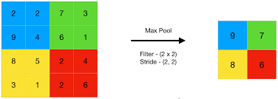
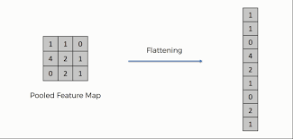
STEPS for model
Step - 3 :
Step - 4 :
Notes:
Step 3 : Maxpooling
Step 4 : Flattening

Slide 9
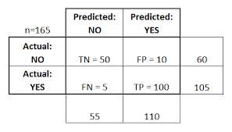
Confusion matrix
Notes:
confusion matrix is a table that is often used to describe the performance of a classification model on a set of test data for which the true values are known. The confusion matrix itself is relatively simple to understand, but the related terminology can be confusing
true positive” for correctly predicted event values. “false positive” for incorrectly predicted event values. “true negative” for correctly predicted no-event values. “false negative” for incorrectly predicted no-event values.
F1 Score=2*(Precision. Recall/(Precision+Recall)) = TP/(TP+(FP+FN)/2) =0.93
Precision=positive predicted value=TP/(TP+FP)=0.91
Recall=True positive rate =TP/(TP+FN)=0.95
TP= number of true positives
FP= number of false positives
FN= number of false negatives

Slide 10

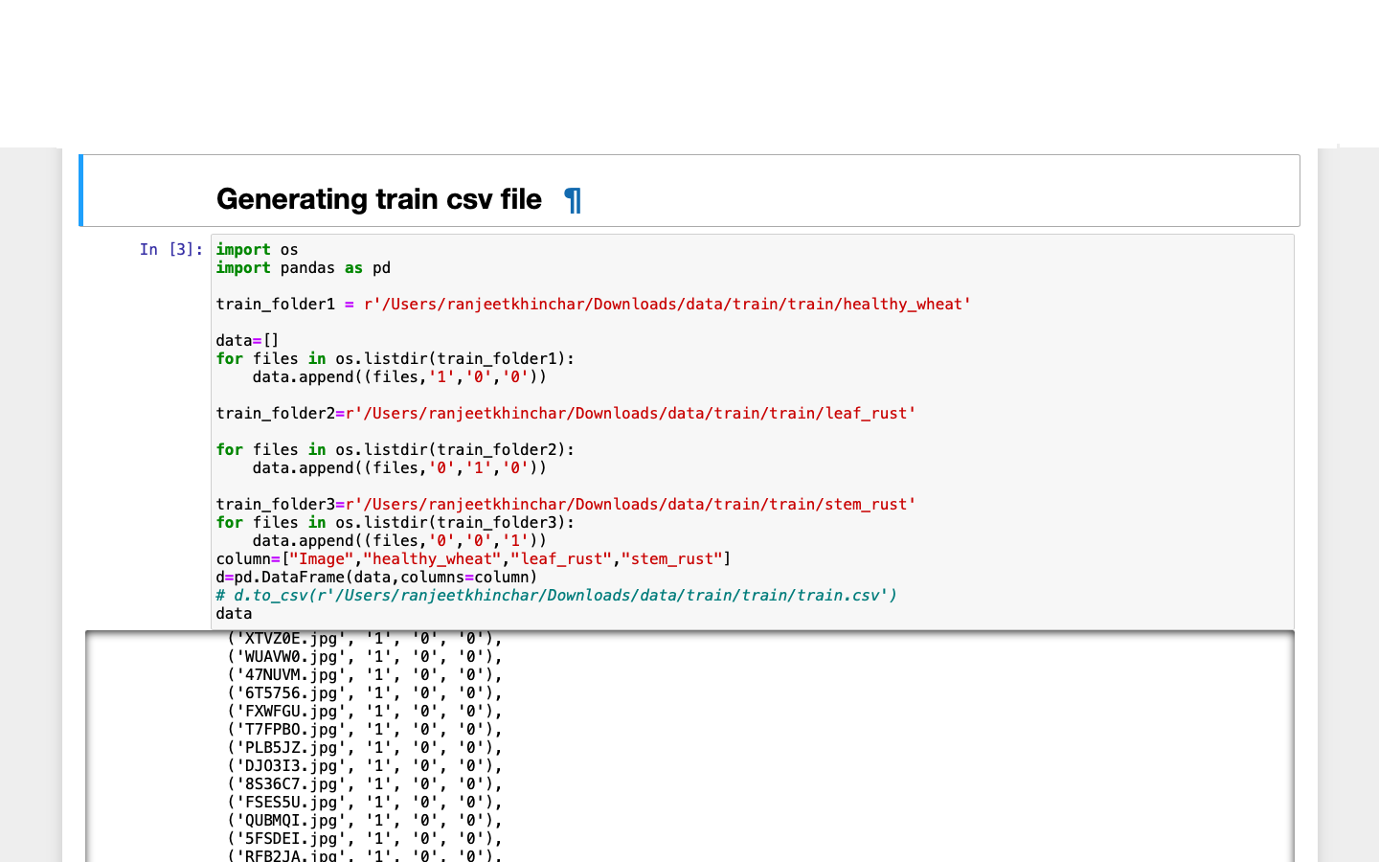
LOADING DATAS

Slide 11
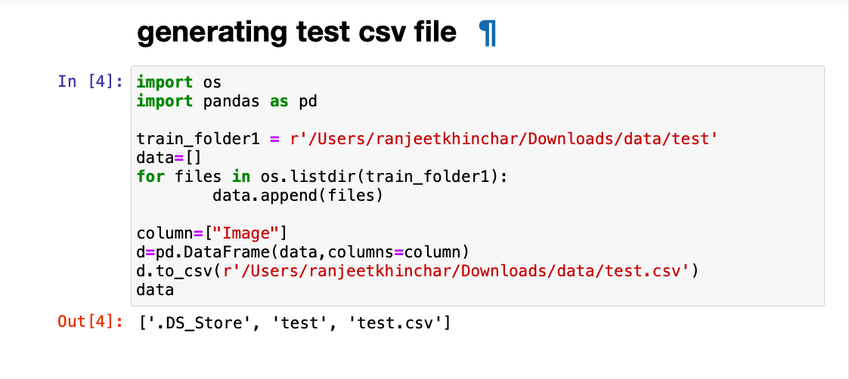

Slide 12
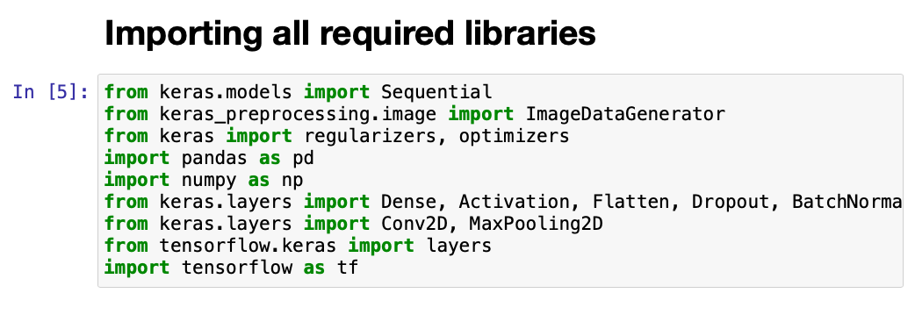
IMPORTING LIBRARIES

Slide 13
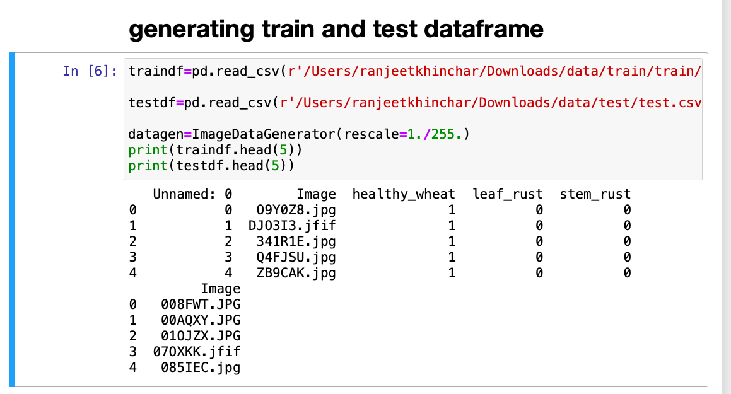

Slide 14
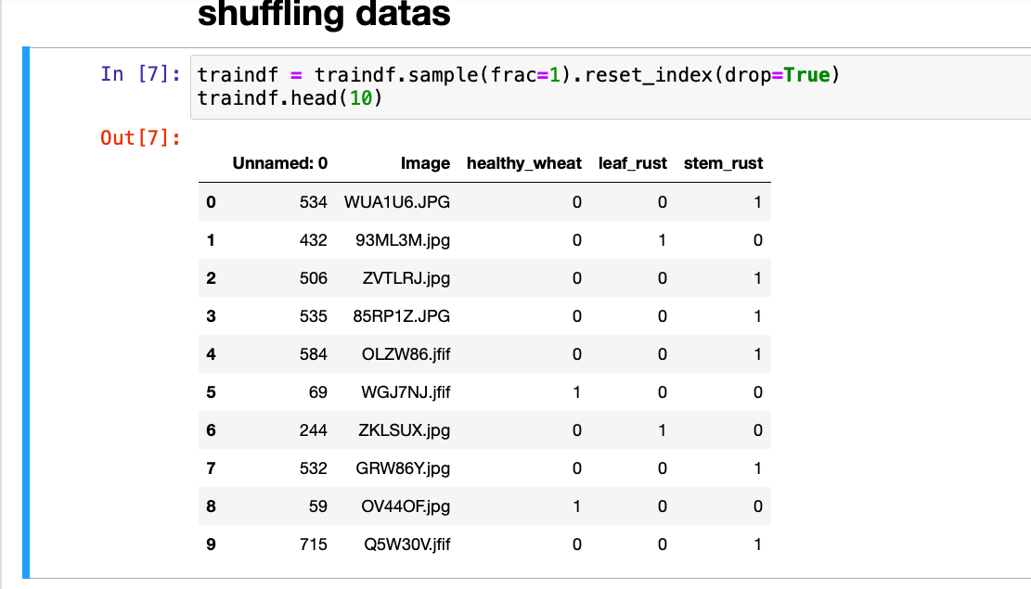

Slide 15
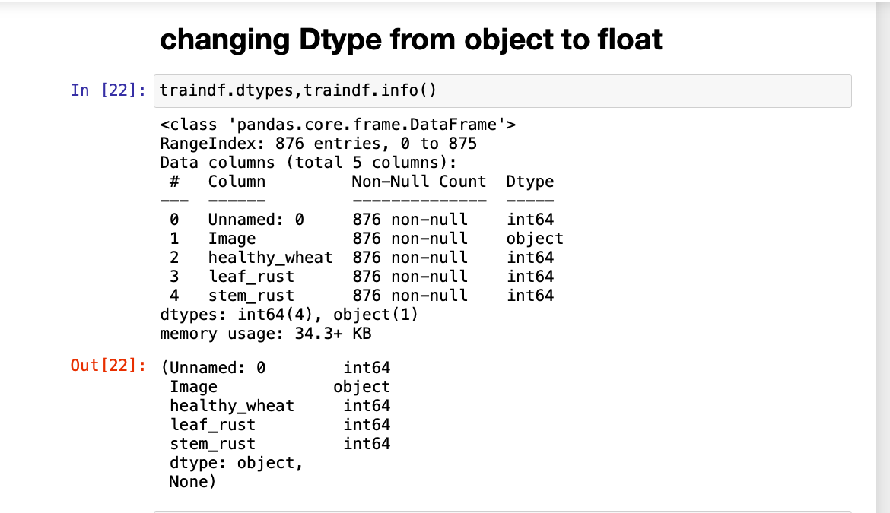

Slide 16
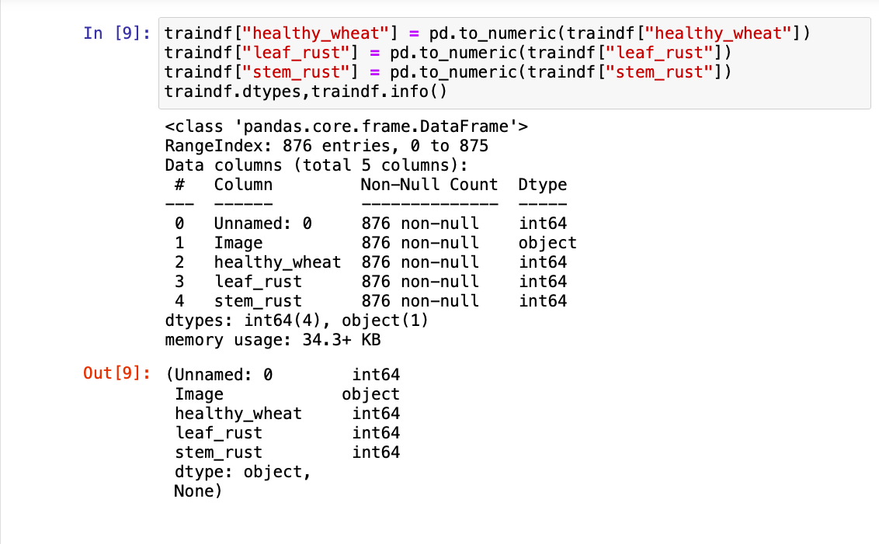

Slide 17
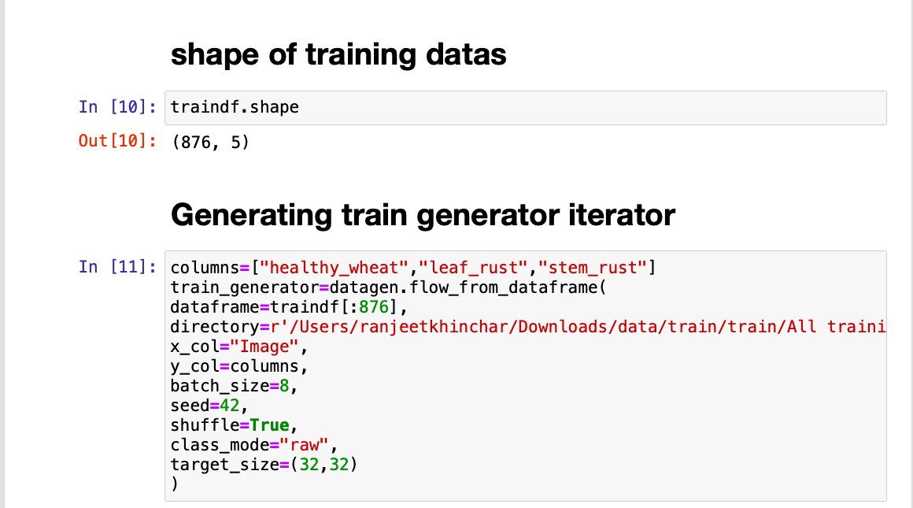
Creating training and validating datasets using flow_from_dataframe

Slide 18
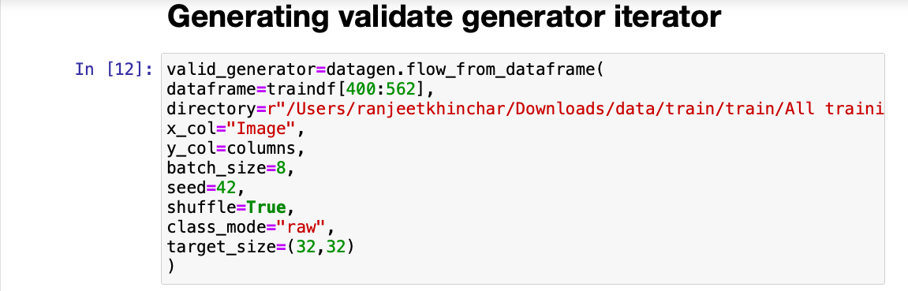
Creating training and validating datasets using flow_from_dataframe

Slide 19
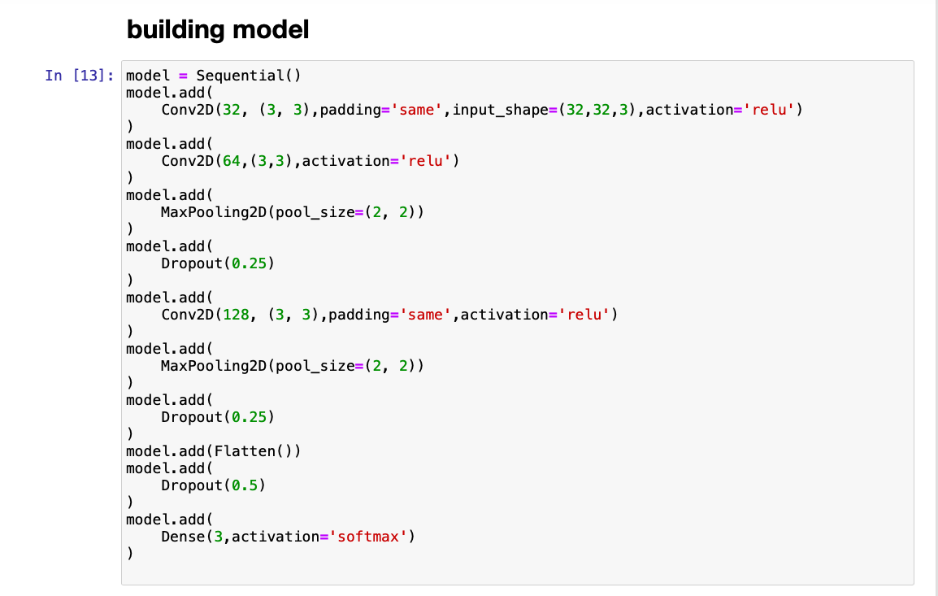
SEQUENTIAL MODEL
Notes:
Building machine learning models that have the ability to generalize well on future data requires thoughtful consideration of the data at hand and of assumptions about various available training algorithms. ... Machine learning consists of algorithms that can automate analytical model building.
Sequential provides training and inference features on this model. `eval`, or ` predict
Conv2D parameter is the numbers of filters that convolutional layers will learn from. It is an integer value and also determines the number of output filters in the convolution.
Padding is a term relevant to convolutional neural networks as it refers to the amount of pixels added to an image when it is being processed by the kernel of a CNN. For example, if the padding in a CNN is set to zero, then every pixel value that is added will be of value zero.
Max pooling is a sample-based discretization process. The objective is to down-sample an input representation (image, hidden-layer output matrix, etc.), reducing its dimensionality and allowing for assumptions to be made about features contained in the sub-regions binned.
In artificial neural networks, the activation function of a node defines the output of that node given an input or set of inputs. ... However, only nonlinear activation functions allow such networks to compute nontrivial problems using only a small number of nodes, and such activationfunctions are called nonlinearities
The term “dropout” refers to dropping out units (both hidden and visible) in a neural network. It refers to ignoring units (i.e. neurons) during the training phase of certain set of neurons which is chosen at random.

Slide 20
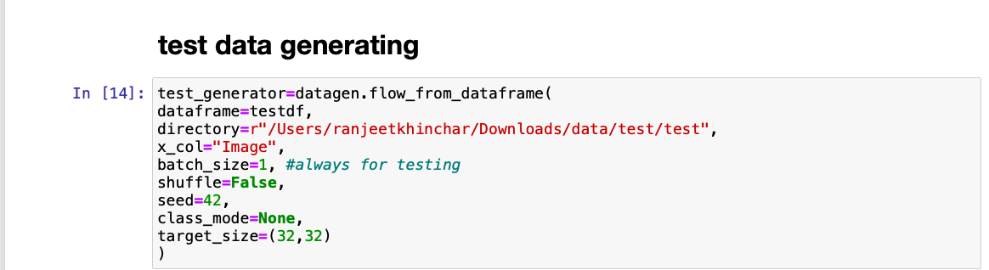
Generate test data
asdsa

Slide 21
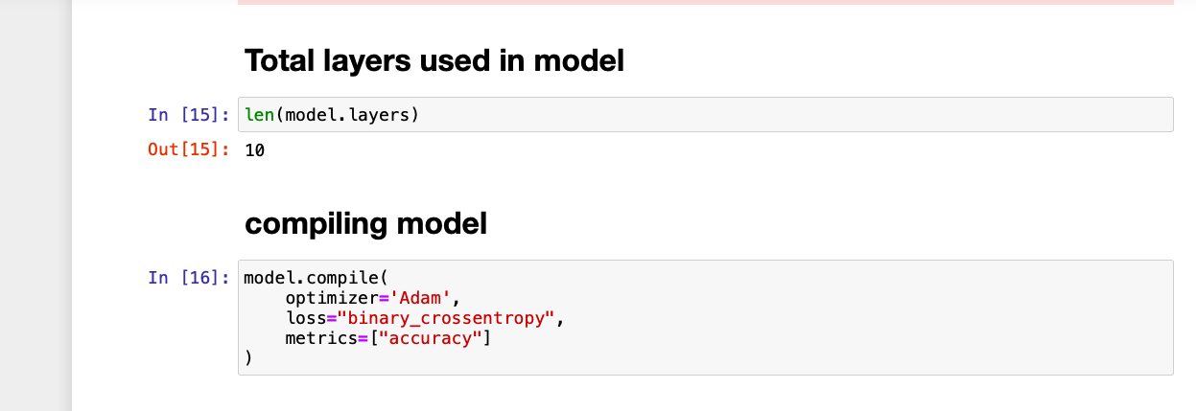
Total no of layers and Compiling model
Notes:
Adam optimizer : Adam is a replacement optimization algorithm for stochastic gradient descent for training deep learning model.
Binary_crossentropy : It is a Sigmoid activation plus a Cross-Entropy loss. Unlike Softmax loss it is independent for each vector component (class), meaning that the loss computed for every CNN output vector component is not affected by other component values.

Slide 22
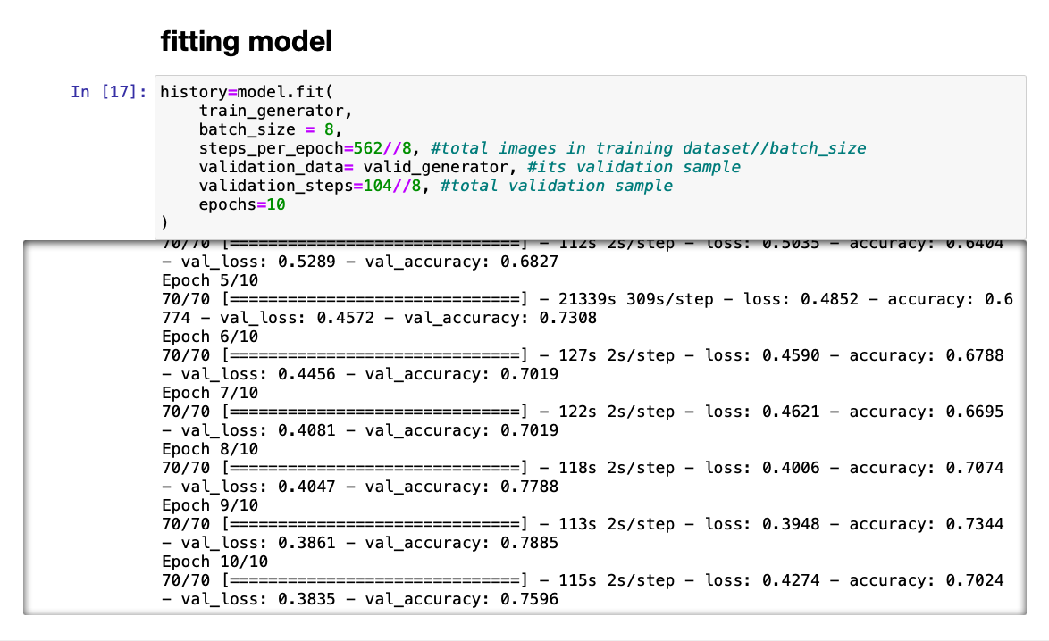
Notes:
Model fitting is a measure of how well a machine learning model generalizes to similar data to that on which it was trained.

Slide 23
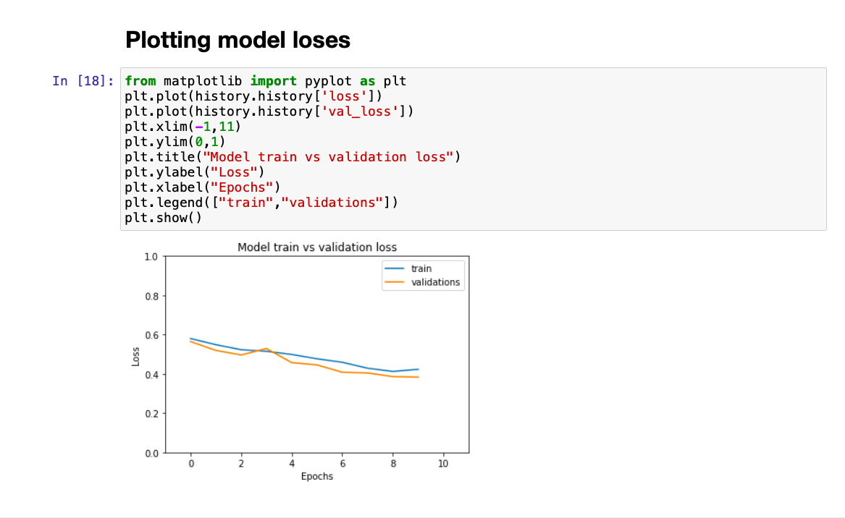

Slide 24
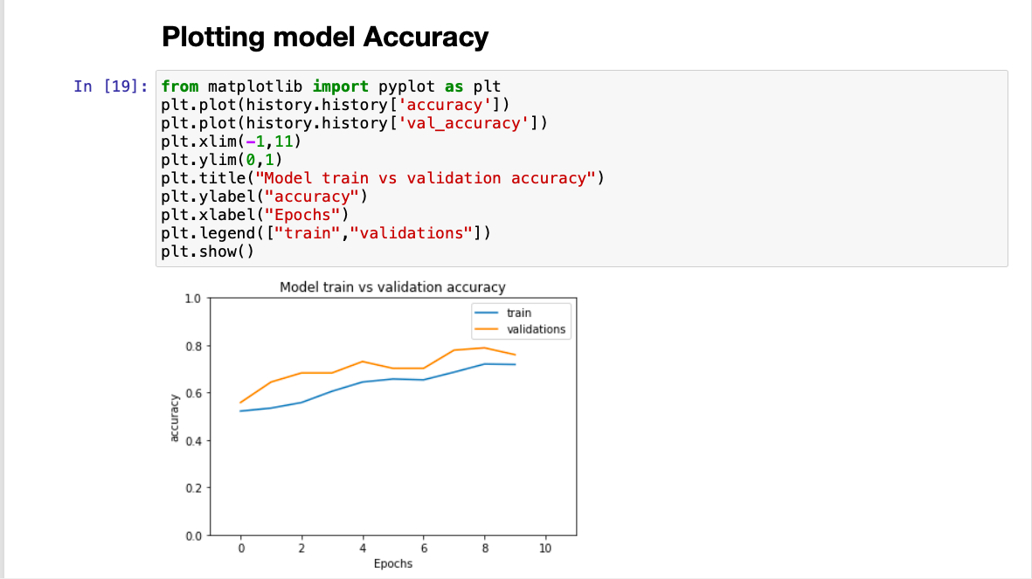

Slide 25
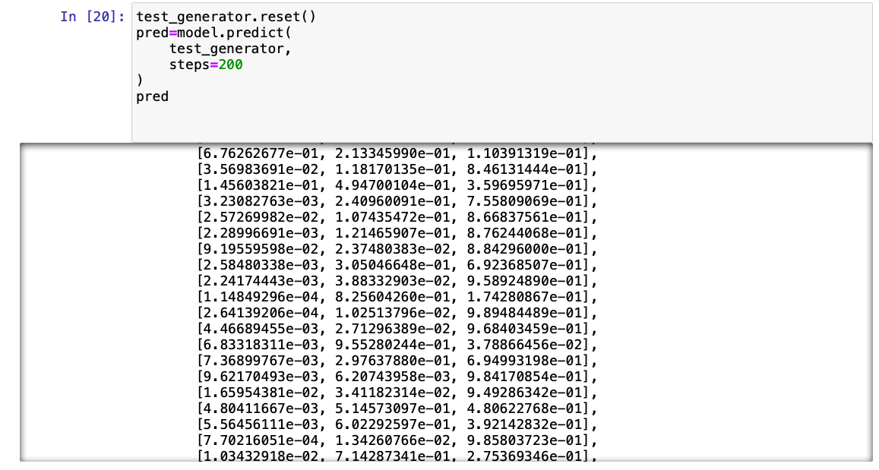
Prediction probabilities

Slide 26
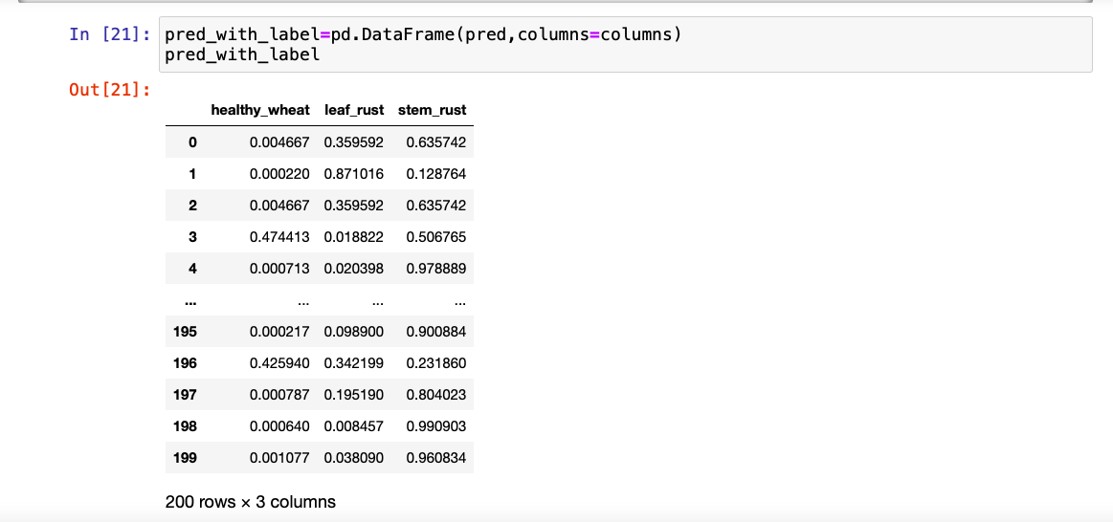
Prediction with labels

Slide 27
SOURCE OF DATA :
LINK : https://www.kaggle.com/shadabhussain/cgiar-computer-vision-for-crop-disease
RESEARCH PAPER :
LINK : Jaware, T., Badgujar, R., Patil, G.: Crop disease detection using image segmentation2, 190–194 (April 2012)

Slide 28
THANK YOU

